Slide 1
DATA ANALYSIS PROJECT

Slide 2
TODAY’S AGENDA
BUSINESS PROBLEMS
ASSUMPTIONS
PROCESS
RESEARCH QUESTIONS
HYPOTHESIS
ANALYSIS AND FINDINGS
SUGGESTIONS

Slide 3
BUSINESS PROBLEM
In recent years, City Hotel and Resort Hotel have seen high cancellation rates.
Each hotel is now dealing with a number of issues as a result, including fewer revenues and less than ideal hotel room use.
Consequently, lowering cancellation rates is hotels’ primary goal in order to increase their efficiency in generating revenue.
The analysis of hotel booking cancellations as well as other factors that are affecting their business and yearly revenue generation are the main topics of this report.

Slide 4
ASSUMPTIONS
No unusual occurrences (outliers) between 2015 and 2017 will have substantial impact on the data used.
The information is still relevant and can be used to analyze a hotel’s possible plans in an efficient manner
There are no unanticipated negatives to the hotel employing any advised techniques.
The hotels are not currently using any of the suggested solutions.
The biggest factor affecting the effectiveness of earning is booking cancellation.
Cancellations result in vacant rooms for the booked length of time.

Slide 5
RESEARCH QUESTIONS
What are the variables that affect hotel reservation cancellations?
How can we reduce hotel reservation cancellations rates?
How will be hotels be assisted in making pricing and promotional
decisions?

Slide 6
HYPOTHESIS
More cancellations occur when the prices are higher.
When there is longer waiting list, customers tend to cancel more frequently.
Majority of clients are coming from offline travel agents to make their reservations.

Slide 7
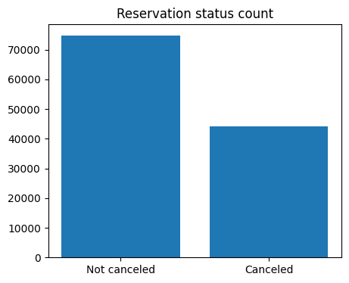
ANALYSIS AND FINDINGS
The accompanying bar graph shows percentage of reservations that are canceled and those that are not.
It is obvious that there are still a significant number of reservations that are not canceled.
There are 37% of clients who canceled the reservation, which has significant impact on hotel’s earnings.

Slide 8
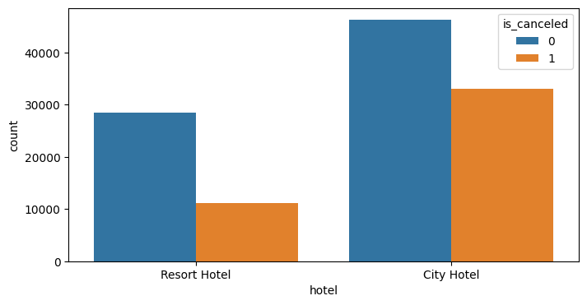
In comparsion to resort hotels city hotels has more bookings.
Its might be possible that resort hotels are expensive than those cities.

Slide 9
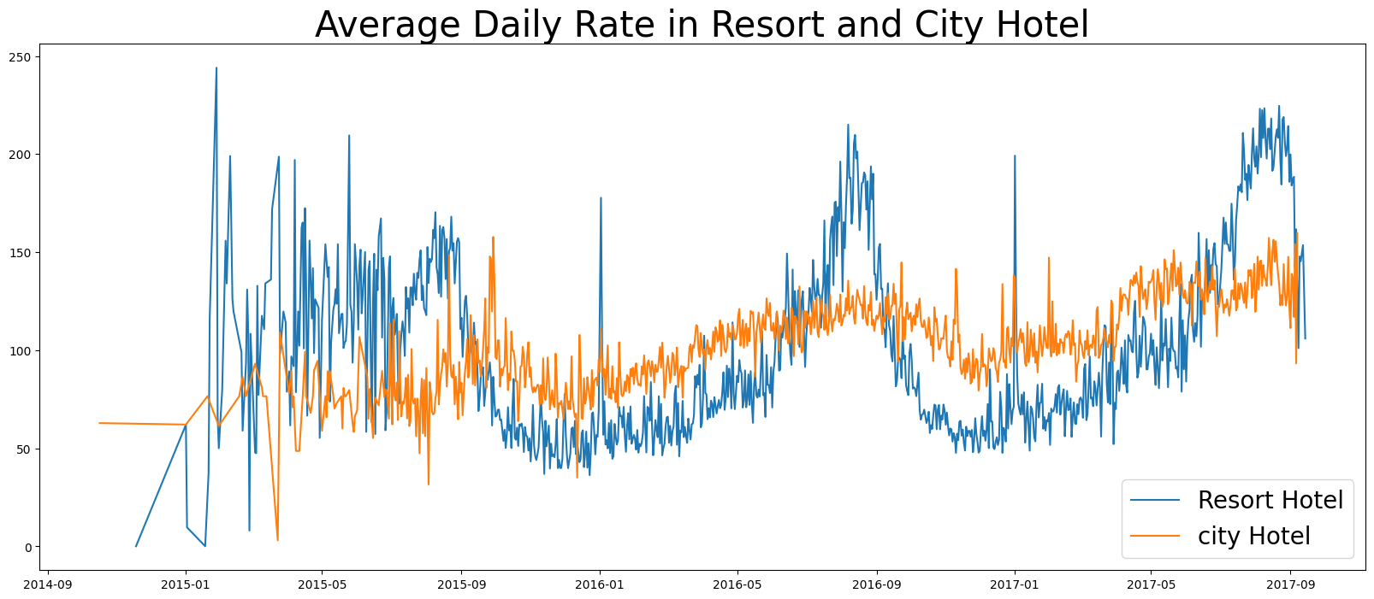
The above ling graph shows that on certain days the average daily rate of city hotel is less than that of resort hotel, and on other days it is even less. It can be assume that on weekends and holidays there is a rise in price of resort hotel.

Slide 10
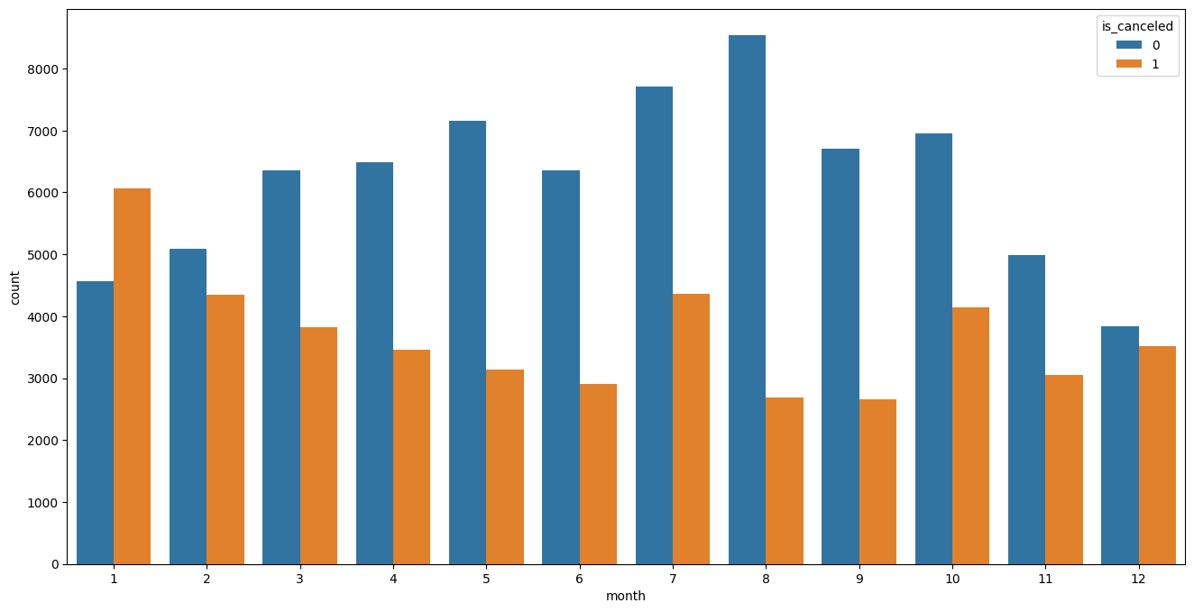
We have developed the grouped bar graph to analyze the months with highest and lowest reservation levels according to reservation status. As can be seen both the numbers of confirmed reservations and cancelled reservation are highest in August And January respectively.

Slide 11
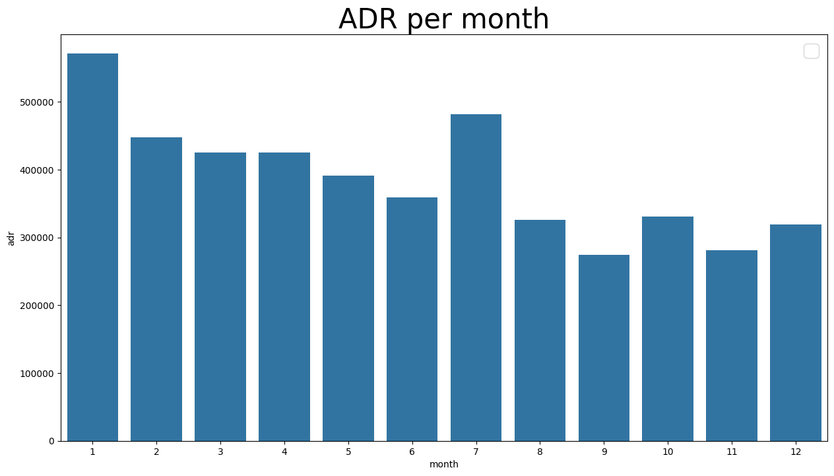
Average Daily rate, The bar graph demonstrate that the cancellations are most common when the prices are higher as in January adr is highest as so cancellations

Slide 12
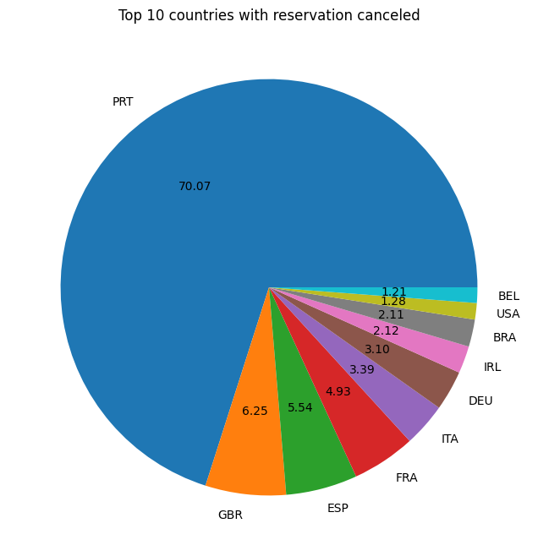
Now let’s see the country with highest reservation cancelled.
Portugal is the top country in cancellation of reservation.

Slide 13
Lets check the area from where guests are visiting the hotel and making the reservations.
Is it coming from direct or groups, offline or online travel agents.
Around 46% of clients from online whereas 27% comes from groups.
Only 4% of clients books hotel directly by visiting them.

Slide 14
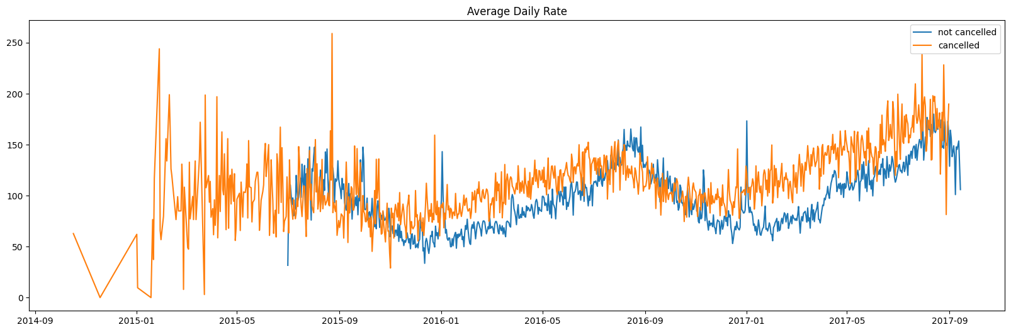
As seen in the graph reservations are cancelled when average daily rate is higher than when it is not cancelled. It clearly proves that the higher rates leads to more cancellations.

Slide 15
SUGGESTIONS
As the cancellations increase in parallel of price.
In order to prevent the cancellations of reservations, hotel could work on their pricing strategies and try to lower the rates of specific hotels based on their locations.
Hotels should also use discounting strategies to attract customers.
As cancellation rates are higher in resorts as compared to city hotel, so resort hotels should provide reasonable price on weekends and holidays.
In the month of January, hotels can start campaigns or marketing with reasonable amount to increase their revenue as the cancellation is highest in this month
They can also increase their service quality in Portugal to reduce cancellation rates.

Slide 16
THANK YOU!

